Slide 1

Votes for sale
Does US foreign aid influence voting patterns in the un general assembly?

Slide 2
Sourcing and cleaning the data

Slide 3
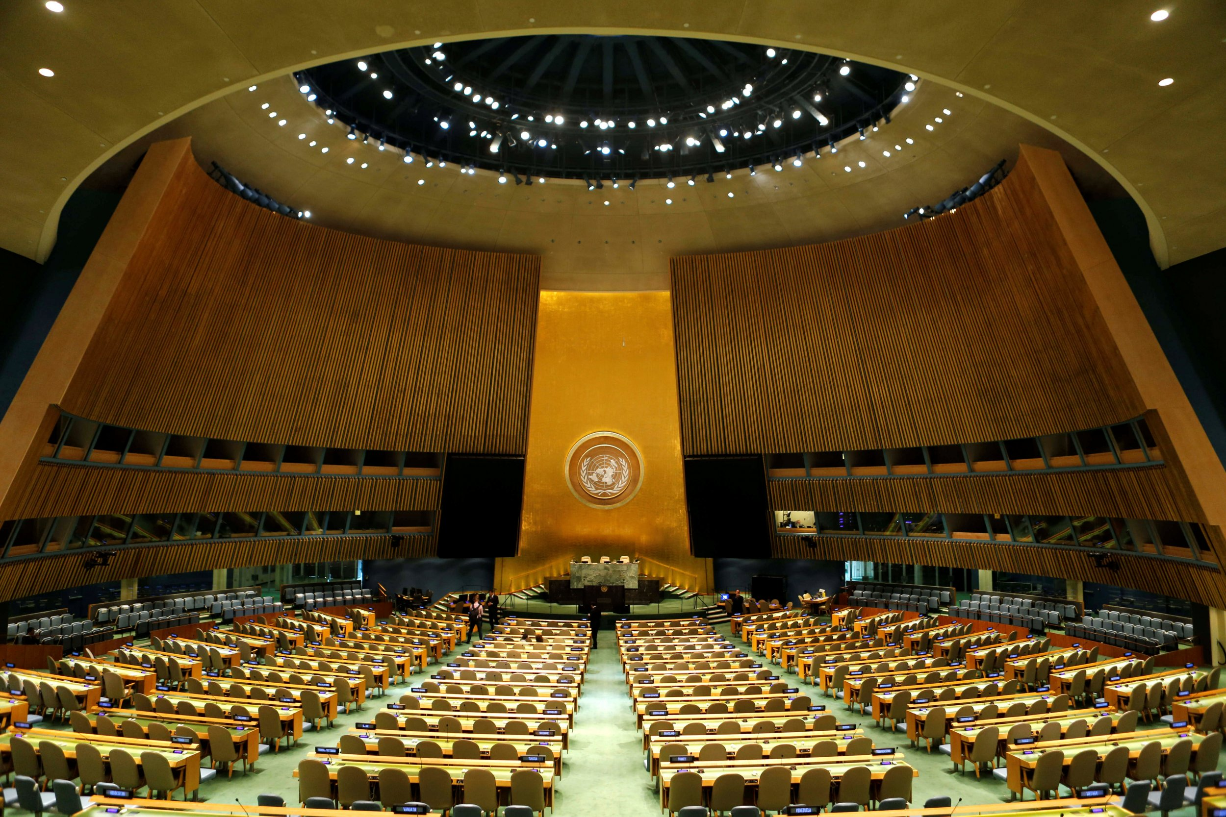
Data sources
Harvard’s Dataverse – UN voting patterns
USAID – Foreign Aid offered by the US State Department each year
World Bank – demographics, economics, and background factors that may help identify clusters in voting patterns other than voting based on foreign aid

Slide 4
Accounting for outliers
UN General Assembly Votes are reported in five different ways:
1: Yes
2: Abstain
3: No
8: Absent (delegate did not show up for the vote)
9: Not a Member (the country was not yet entitled to vote when this issue was decided)
1, 2, and 3 can be thought of as points on a quantitative spectrum; the political distance from “Yes” to “No” is further than the political distance from “Yes” to “Abstain.”
8 and 9 do not represent directly usable data; they are not quantitatively related to a country’s opinions about a UN resolution. Absence is not a point on the political spectrum.

Slide 5
Accounting for outliers
Votes of “Absent” (8) were converted to votes of “abstain.” (2)
This assumes that most absences were voluntary
This is a reasonable assumption because voting in the General Assembly is one of the more important duties of a nations’ diplomatic corps; there are probably few cases where an entire nation-state is literally unable to send one delegate to attend a meeting and vote.
Votes of “Not a Member” (9) were removed from the dataset.
This is reasonable because countries that are not yet members have no ability to vote, so the fact that they did not vote does not provide any useful information.
The only way ‘not a member’ votes could add useful data is if countries sometimes try harder to become members as a result of receiving foreign aid payments.

Slide 6
Merging the datasets
The two datasets (Harvard and USAID) use different country names and different country codes to refer to each country; about 20 countries had no record ID that uniquely and specifically identified them across both datasets.
Each country is associated with several thousand votes.
To merge the datasets more efficiently, the first step was to create a 1:1 map that reliably links each country to a specific code.
Missing values were filled in using the parallel database; e.g., if both Harvard and USAID had a country codes as “CZH,” and Harvard identified that country as the Czech republic, but USAID did not identify that country with a full name, then the country was assumed to be the Czech Republic in both datasets.
A very small number of records (<0.1%) appeared to still have no reliable name even after checking both databases. These records all date to 2014 or later; the most likely cause of the missing values is that they belong to relatively newer countries such as East Timor and South Sudan.

Slide 7
DATA EXPLORATION

Slide 8
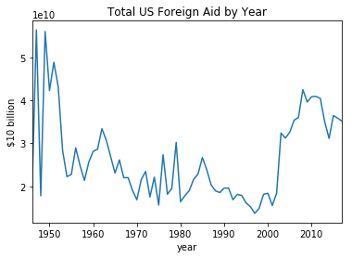
Total us aid over time
US Aid to foreign countries peaked in the 1950s and again in the early 2000s.
Aid had significant but not extreme variance; the highest levels of aid were only about 3x the lowest levels of aid.
All financial variables are expressed in constant 2010 US dollars.

Slide 9
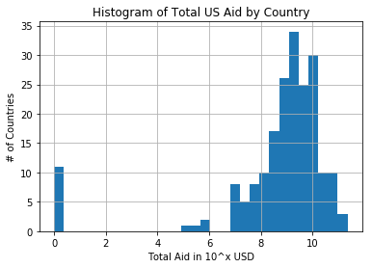
Total us aid by country
The amount of US Aid given to each foreign country varied very widely, requiring a logistic x-axis to show the full range.
11 countries have received zero foreign aid.
All financial variables are expressed in constant 2010 US dollars.

Slide 10
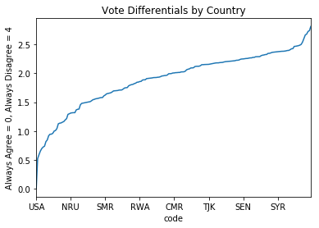
Voting patterns by country
On a scale of 0 to 4, 0.0 means perfect agreement with the US, 1.0 means the country did nothing but abstain, and 4.0 means perfect disagreement with the US.
Most countries scored between 1.5 and 2.5, meaning that they were somewhat more likely to disagree with the USA.
Western Europe and Oceania voted with the US most frequently, and sub-Saharan Africa voted with the US least frequently.
Strongest Agreement ISR 0.519 EAZ 0.588 TWN 0.651 WGERMANY 0.695 PLW 0.720 GBR 0.735 FSM 0.814 CAN 0.844 FRA 0.917 LUX 0.943 BEL 0.944 NLD 0.959 ITA 0.998 AUS 1.008 | Strongest Disagreement SYR 2.376 CUB 2.378 LBY 2.381 DJI 2.502 ERI 2.542 ZWE 2.602 NAM 2.666 VNM 2.681 BRN 2.727 YEM 2.741 PRK 2.814

Slide 11
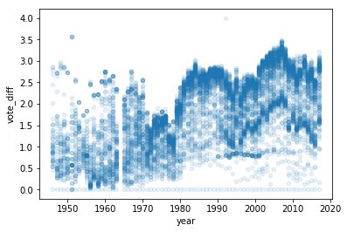
Voting patterns OVER TIME
On a scale of 0 to 4, 0.0 means perfect agreement with the US, 1.0 means the country did nothing but abstain, and 4.0 means perfect disagreement with the US.
Each white circle represents one country, and darker circles represent more countries, up to a solid navy circle, which represents 10+ countries.
On average, countries have increased their disagreement with the USA over time.

Slide 12
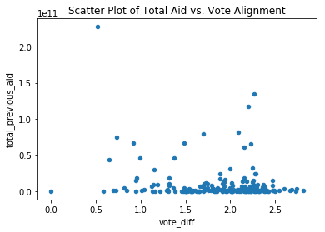
Voting patterns based on us aid
On a scale of 0 to 4, 0.0 means perfect agreement with the US, 1.0 means the country did nothing but abstain, and 4.0 means perfect disagreement with the US.
Total aid is expressed in hundreds of billions of constant 2010 US Dollars.
With the exception of Israel, in the top-left corner, there is little correlation between total aid received by a country and that country’s lifetime history of votes in the General Assembly.

Slide 13
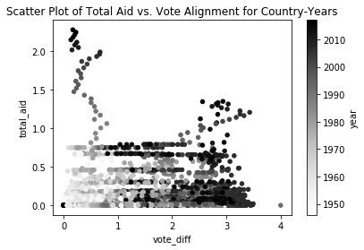
Voting patterns based on AID & TIME
On a scale of 0 to 4, 0.0 means perfect agreement with the US, 1.0 means the country did nothing but abstain, and 4.0 means perfect disagreement with the US.
Total aid is expressed in hundreds of billions of constant 2010 US Dollars.
Votes from earlier years use white circles, and votes from later years use black circles.
Most countries have disagreed with the US more often as the years have gone by.

Slide 14
Linear regressions

Slide 15
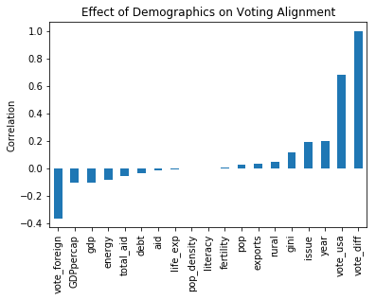
Identifying useful variables
Most demographic variables had little or no correlation with a country’s voting record.
The variables that did have strong correlations were artificial, e.g., vote_foreign is part of the formula for vote_diff.
The “real” variables that correlated most strongly with voting alignment were GDP per capita and the GINI index of economic inequality.
The correlations with economic variables were statistically significant, but weak in their effects.

Slide 16
Foreign aid does not explain voting
OLS Regression Results
======================================================================
Dep. Variable: vote_diff R-squared: 0.044
Model: OLS Adj. R-squared: 0.044
Method: Least Squares F-statistic: 264.6
Date: Mon, 11 Nov 2019 Prob (F-statistic): 1.73e-277
Time: 19:06:09 Log-Likelihood: -56968.
No. Observations: 28780 AIC: 1.139e+05
Df Residuals: 28774 BIC: 1.140e+05
======================================================================
coef std err t P>|t| [0.025 0.975]
----------------------------------------------------------------------
const 1.5688 0.065 24.033 0.000 1.441 1.697
total_aid 3.526e-13 5.45e-13 0.647 0.518 -7.16e-13 1.42e-12
GDPpercap -1.63e-05 6.14e-07 -26.527 0.000 -1.75e-05 -1.51e-05
debt -0.0034 0.000 -9.862 0.000 -0.004 -0.003
gini 0.0178 0.001 13.649 0.000 0.015 0.020
exports 0.0075 0.001 14.031 0.000 0.006 0.009
======================================================================
Omnibus: 122395.966 Durbin-Watson: 1.537
Prob(Omnibus): 0.000 Jarque-Bera: 3522.188
Skew: -0.031 Prob(JB): 0.00
Kurtosis: 1.287 Cond. No. 1.48e+11
======================================================================
The effect size of US foreign aid on voting records was so small as to be irrelevant for practical purposes.
Adding US foreign aid to the model does not improve r², and yields a worse AIC score.
Removing outliers, normalizing the variables, and changing the amount of aid that is measured (e.g., only 1 year, or only the most recent 5 years) does not rescue foreign aid as an explanatory variable – no matter how it is calculated, foreign aid still has virtually zero explanatory power.

Slide 17
Economic variables do help explain voting
Despite weak correlations, four economic variables had a reasonably large effect size and were significant at the p < 0.001 level.
GDP per capita – rich countries are more likely to vote with the US
Foreign Debt – heavily indebted countries are more likely to vote with the US
GINI Index – countries with high levels of inequality are less likely to vote with the US
Exports – countries that rely on exports to fuel their economy are less likely to vote with the US
The predictive power of these economic variables is robust to the removal of outliers and/or the introduction of foreign aid as an additional independent variable.
Although there is some collinearity among these variables, the variance inflation factor is always less than 1.25, suggesting that each variable helps capture a unique trend.

Slide 18
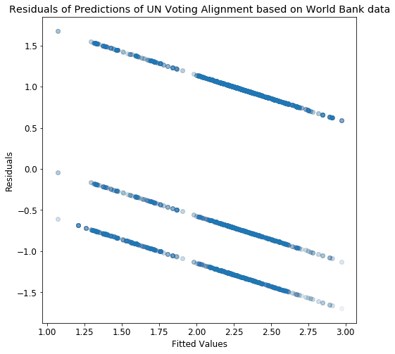
The residuals are too regular
Using the model that yields the best predictive power leaves us with a troubling pattern in the residuals.
Residuals should be randomly distributed with respect to their fitted values, but as shown in the graph to the right, all residuals fell into three tight bands.
Some loose banding would be expected based on the discrete nature of the data (any given vote can only be yes, no, or abstain), but that does not explain the extremely tight bands shown here.

Slide 19
Unsupervised learning

Slide 20
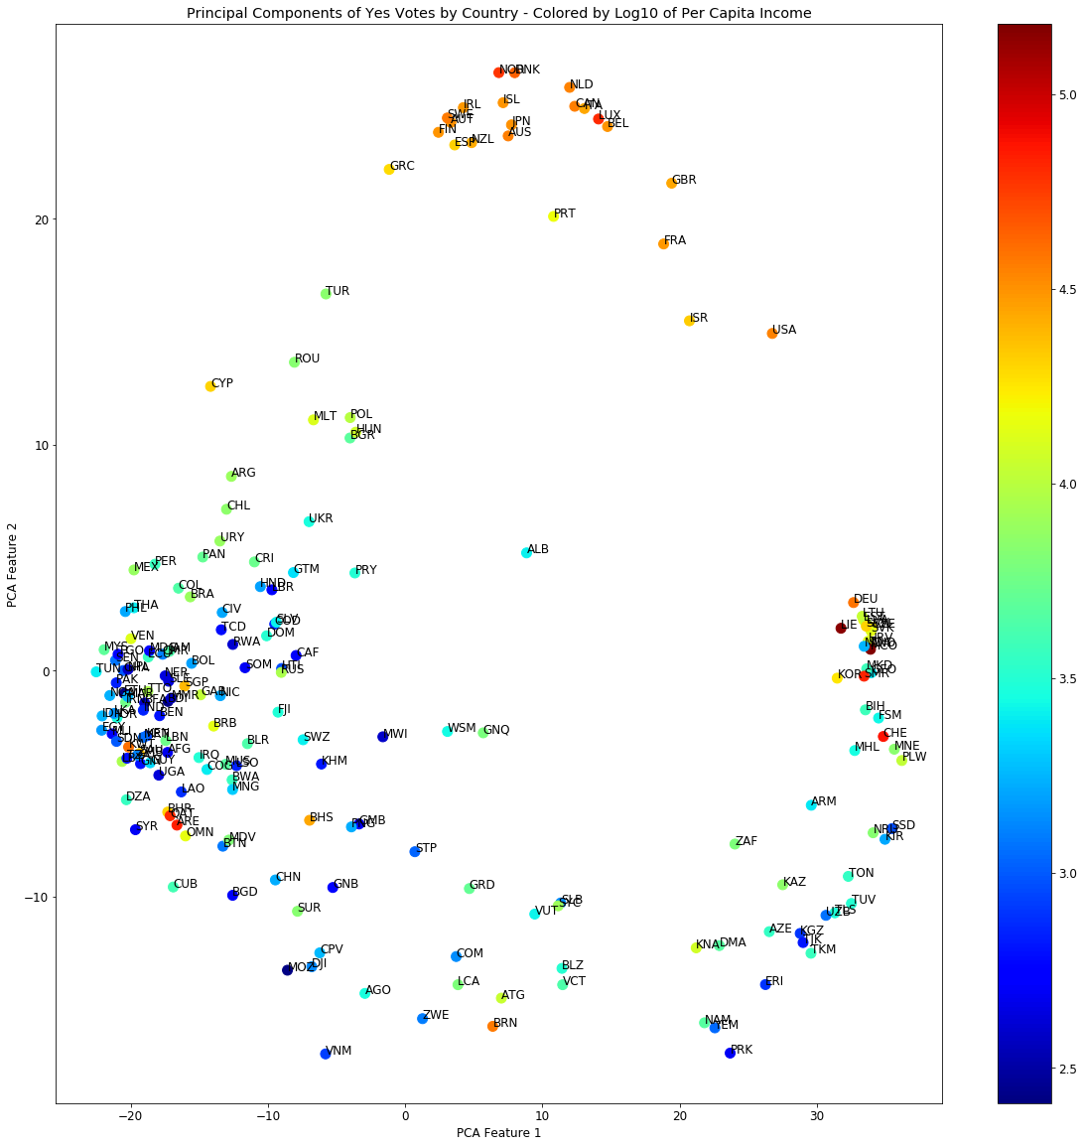
PRINCIPAL COMPONENT ANALYSIS
Each country’s yes votes on all 4,940 of the resolutions can be plotted in a matrix of 0’s and 1’s.
The matrix, in turn, can be reduced from 4,940 dimensions to 2 dimensions through principal component analysis (“PCA”).
PCA helps illustrate which countries tend to vote together on UN resolutions.
In the graph on the right, wealthier countries are colored in red, and countries that vote together appear closer together.

Slide 21
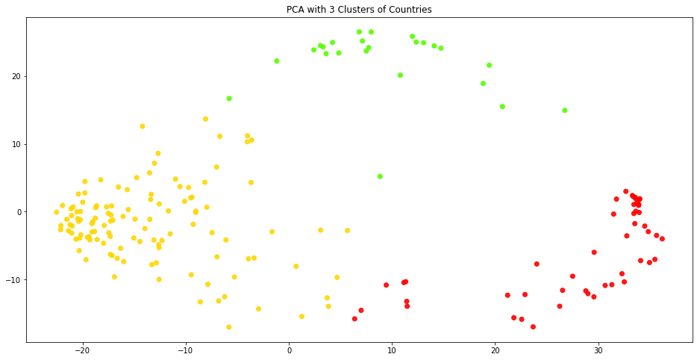
Clustering
The PCA results in a graph that appears to have three distinct clusters.
Countries in the top, green cluster are relatively developed and democratic.
Countries in the left-hand, yellow cluster are typically less developed, and most of them are former colonies.
Countries in the right-hand, red cluster have a variety of traits, but include many so-called “rogue states” such as Iran and North Korea.

Slide 22
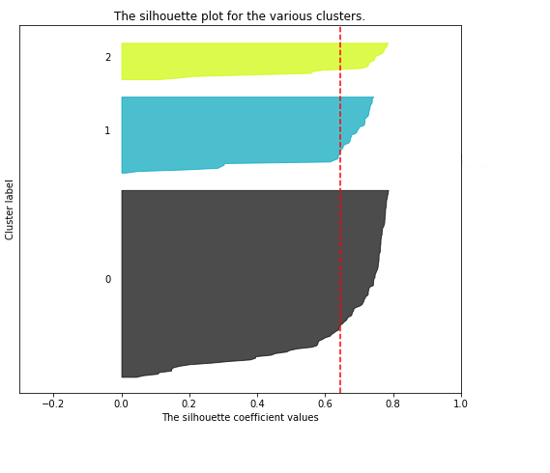
SILHOUETTE SCORES
The robustness of a proposed clustering can be tested by measuring its silhouette scores.
A silhouette score above 0.5 typically indicates that a reasonable structure has been identified.
For the UN voting data, silhouettes cores are maximized by sorting the data into exactly 3 clusters.
The profiles on the right show that each cluster is uniformly positive and has a relatively gentle curve, both of which support the model.

Slide 23
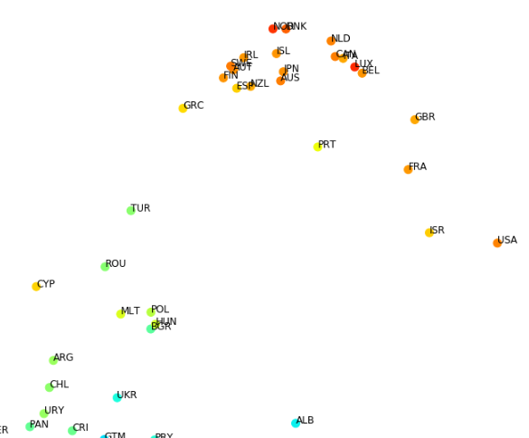
INTERPRETING THE CLUSTERS
Although the mathematical evidence suggests that there are only 3 main voting blocs, there are some subjectively interesting groupings near the top of the PCA graph.
Almost all of the former Soviet republics are concentrated near the top of the left-hand cluster, near several Latin American states.
The four most ‘hawkish’ members of the NATO bloc – America, Britain, France, and Israel – are notably to the right of the center of the topmost cluster.
Greece, Spain, Iceland, and Ireland, all of which have had trouble with recent austerity packages, are notably to the left of the center of the topmost cluster.

Slide 24
conclusions

Slide 25
Value alignment vs. quid pro quo
The fact that foreign aid apparently has no impact on UN General Assembly votes does not necessarily mean that foreign aid is ineffective.
Countries who receive US foreign aid may ‘repay’ that investment in less publicly visible forums, such as patent enforcement, trade deals, and/or covert military assistance.
The UN General Assembly has high visibility but low practical impact, so it makes sense for countries to use it to satisfy domestic political constituents rather than foreign donors.
Even if foreign aid has no impact on foreign policy, it may still be a useful political tool.
Donating money to countries whose values align with those of the United States may help those countries grow stronger and/or retain their current value systems.
The economic variables that correlate most strongly with UN voting alignment (GDP per capita, GINI index of inequality, etc.) are reasonable proxies for social and economic freedoms. This supports the idea that the US is focusing its aid on countries that are politically aligned with the US in some way.

